Slide 1
Adams House
Fall Pre-Health Meeting
September 24, 2023

Slide 2
Introduction
I. Welcome!
II. Why do you want to be a physician or enter the pre-health track?
III. Goal-setting
Risk/benefit ratio in decision-making
Determine your goals both inside and outside of medicine
Notes:
Varnel

Slide 3
Resources
I. Resident Tutors:
Varnel Antoine (Co-Chair), Dan Kim (Co-Chair), Leen Al Kassab, Carolina Jaramillo, Maud Jansen, David Morse, Daniel Echelman, Chad Vigil
E-mail: adams-medical@lists.fas.harvard.edu
WEBSITE: https://adamshouse.harvard.edu/pre-med-advising
Your pre-health tutors:
Notes:
Varnel

Slide 4
Resources
II. Non-resident tutor (NRT) staff
Who: Health professionals across stages of training and career paths (non-medicine NRT’s also available - let us know if you’re thinking of a different health professions grad school!)
Role
Advise across pre-med trajectory
Provide insight into medicine as a career choice
Assist you with school list, application, personal statement, mock interviews
Write the Committee Letter
Get to know your NRT! They are the key support system in preparation for and during the application process
Pairings will be announced in October
Notes:
Varnel

Slide 5
Resources
III. Mignone Center for Career Success (MCS)
Rob Harrington and Oona Ceder (premed@fas.harvard.edu)
They should be contacted as soon as possible if you are considering non-MD programs (e.g. vet school, dental school, PA school, nursing school)
***MCS website: https://careerservices.fas.harvard.edu/channels/pre-med-students/
Premedical Information for Harvard Students
Sign up to the pre-health listserv!
Medical school information – including alumni evaluations of schools (this is most appropriate when deciding on a school list for applications)
Notes:
Varnel

Slide 6
Resources
IV. Published books, other resources
Medical Schools Admissions Requirements (MSAR) - online database that enables you to browse, search, sort, and compare information about U.S. and Canadian medical schools and BS/MD programs, and more (1 and 2-year subscriptions) $36 value
MCS Booklet with Harvard Undergraduate-specific data
AMCAS website --http://www.aamc.org/students/amcas
Other – medical school websites
V. Financial resources
Fee Assistance Program (up to two calendar years from when you submit your Fee Assistance Program application)
Reduced registration fee, from $330 to $135, for MCAT exams until December 31st of the year you submit your Fee Assistance Program application
Complimentary access to the Medical School Admission Requirements (MSAR) website ($36 value)
Waiver for all AMCAS fees for one (1) application submission with up to 20 medical school designations ($1030 value)
Waiver for AAMC PREview professional readiness exam registration fees ($100 value).
Effective calendar year 2022, the AAMC has modified two of its eligibility requirements for the Fee Assistance Program:
Removed the U.S. citizenship and certain visa status eligibility requirements, and will instead require a U.S. address.
Removed the requirement for parental financial information for applicants age 26 and over on the day the application is submitted.
Notes:
Varnel

Slide 7
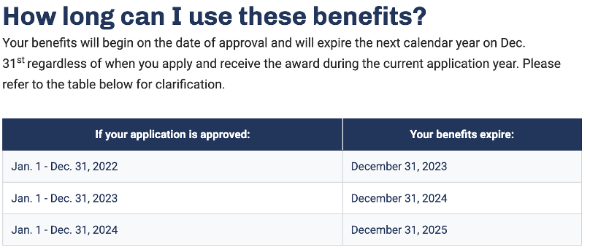
Resources
Financial Aid Office
Reach out to your financial aid officer about your options to taking out additional loans to apply to graduate school (deferred while in graduate school and more)
Notes:
Varnel

Slide 8
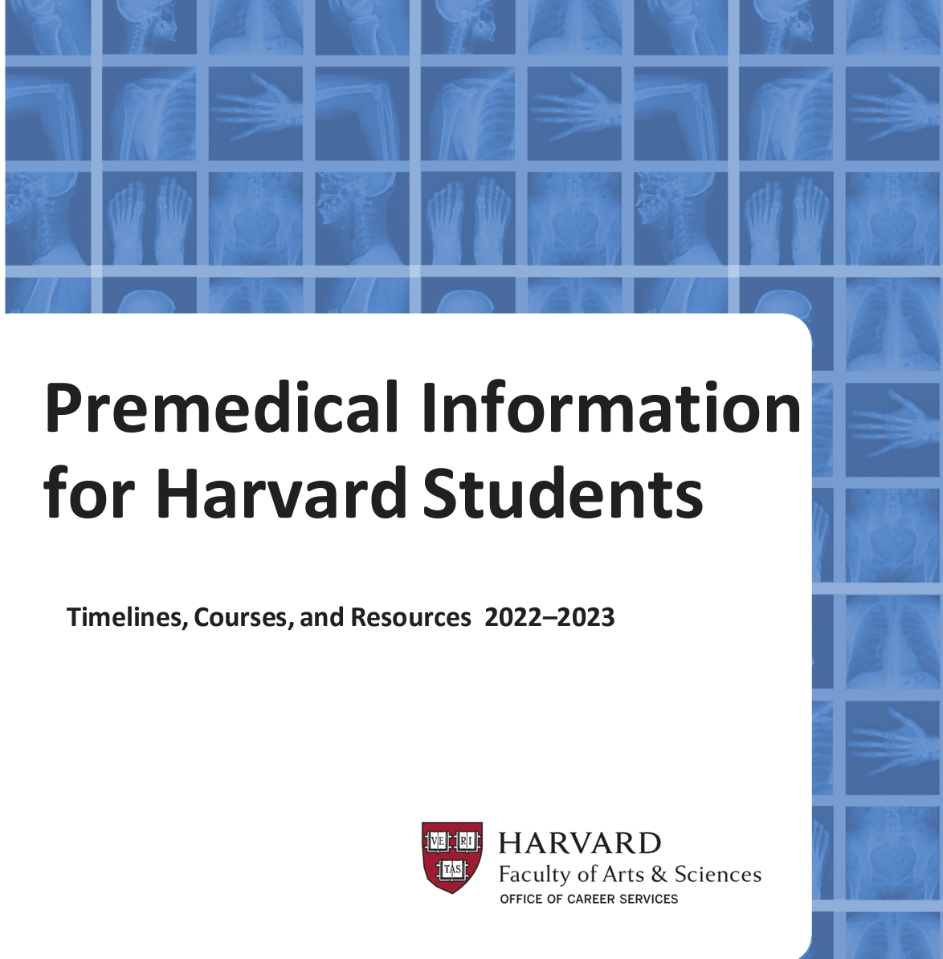
Components of a Successful Med School App
I. Numbers
Grades—yes, they are important [MCS Med School Admission Data];
Don’t be disheartened; admissions look favorably on an upward trend in your academic record
Importance of science GPA.
C or lower; see MCS premed/ academic adviser/ resource center for study strategies
Pre-med requirements (for a letter grade)–
One year of general or inorganic chemistry with lab • One year of organic chemistry
with lab • One year of general physics with lab • One year of biology with lab
• One year of English • Math/Statistics •English
Please see OCS website for detailed list and suggestions (premed bluebook)
Notes:
Leen
https://careerservices.fas.harvard.edu/admissions-academic-requirements-policies-premed/
OCS publication Medical School Admissions Data
Required premedical courses must be taken for a letter grade to be accepted by medical schools
Don’t be disheartened or discouraged from pursuing medicine if your first science grades do not meet your expectations. Medical school admissions committees look favorably on an upward trend in your academic record. That being said, if you have received a C or lower grade in a science course, it is a good idea to make an appointment with an OCS premedical/pre-health adviser, your academic adviser, and/or an adviser at the Academic Resource Center to review your course load, your extracurricular activities, and study strategies as you continue your studies.

Slide 9
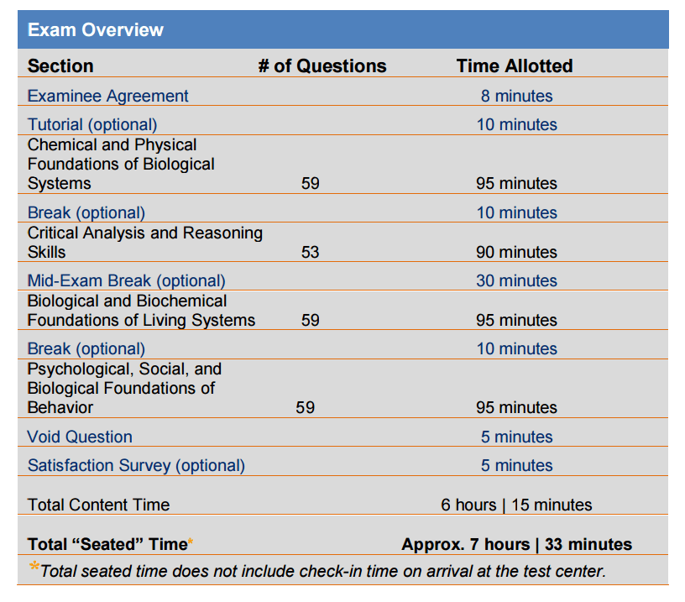
Components of a Successful Med School App
II. MCAT
Prep coursework
MCAT practice manuals, old exams from AAMC
Kaplan/Princeton (both ~$1500), ExamKrackers
ANKI (free desktop and android flashcard app, $25 for iOS-Phone/iPad)
YouTube ANKI Tutorials
Look at Reddit and google for Pre-made ANKI Decks for MCAT prep
UWorld
What is it: Electronic, but not adaptive
When is it: Now offered very frequently, but dates fill up fast
How long does it last: Expires in ~ 3 years
How to afford: Please apply to the Fee Assistance Program before booking your MCAT to save on money with reduced MCAT costs and waived AMCAS primary and supplemental applications
Notes:
Leen

Slide 10
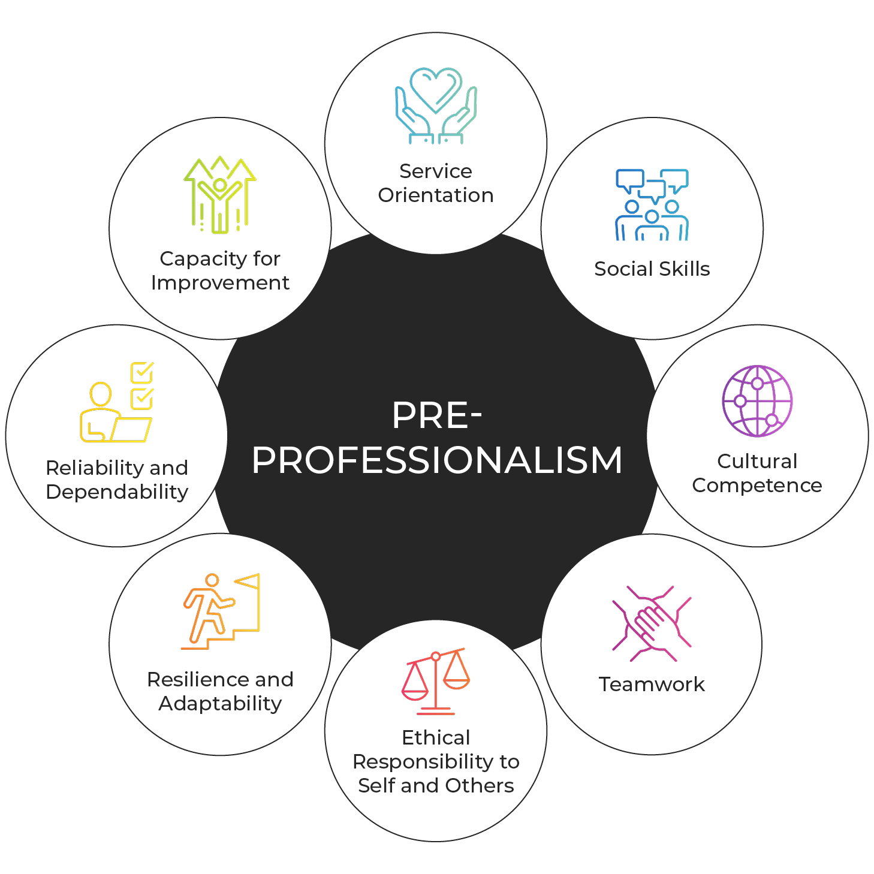
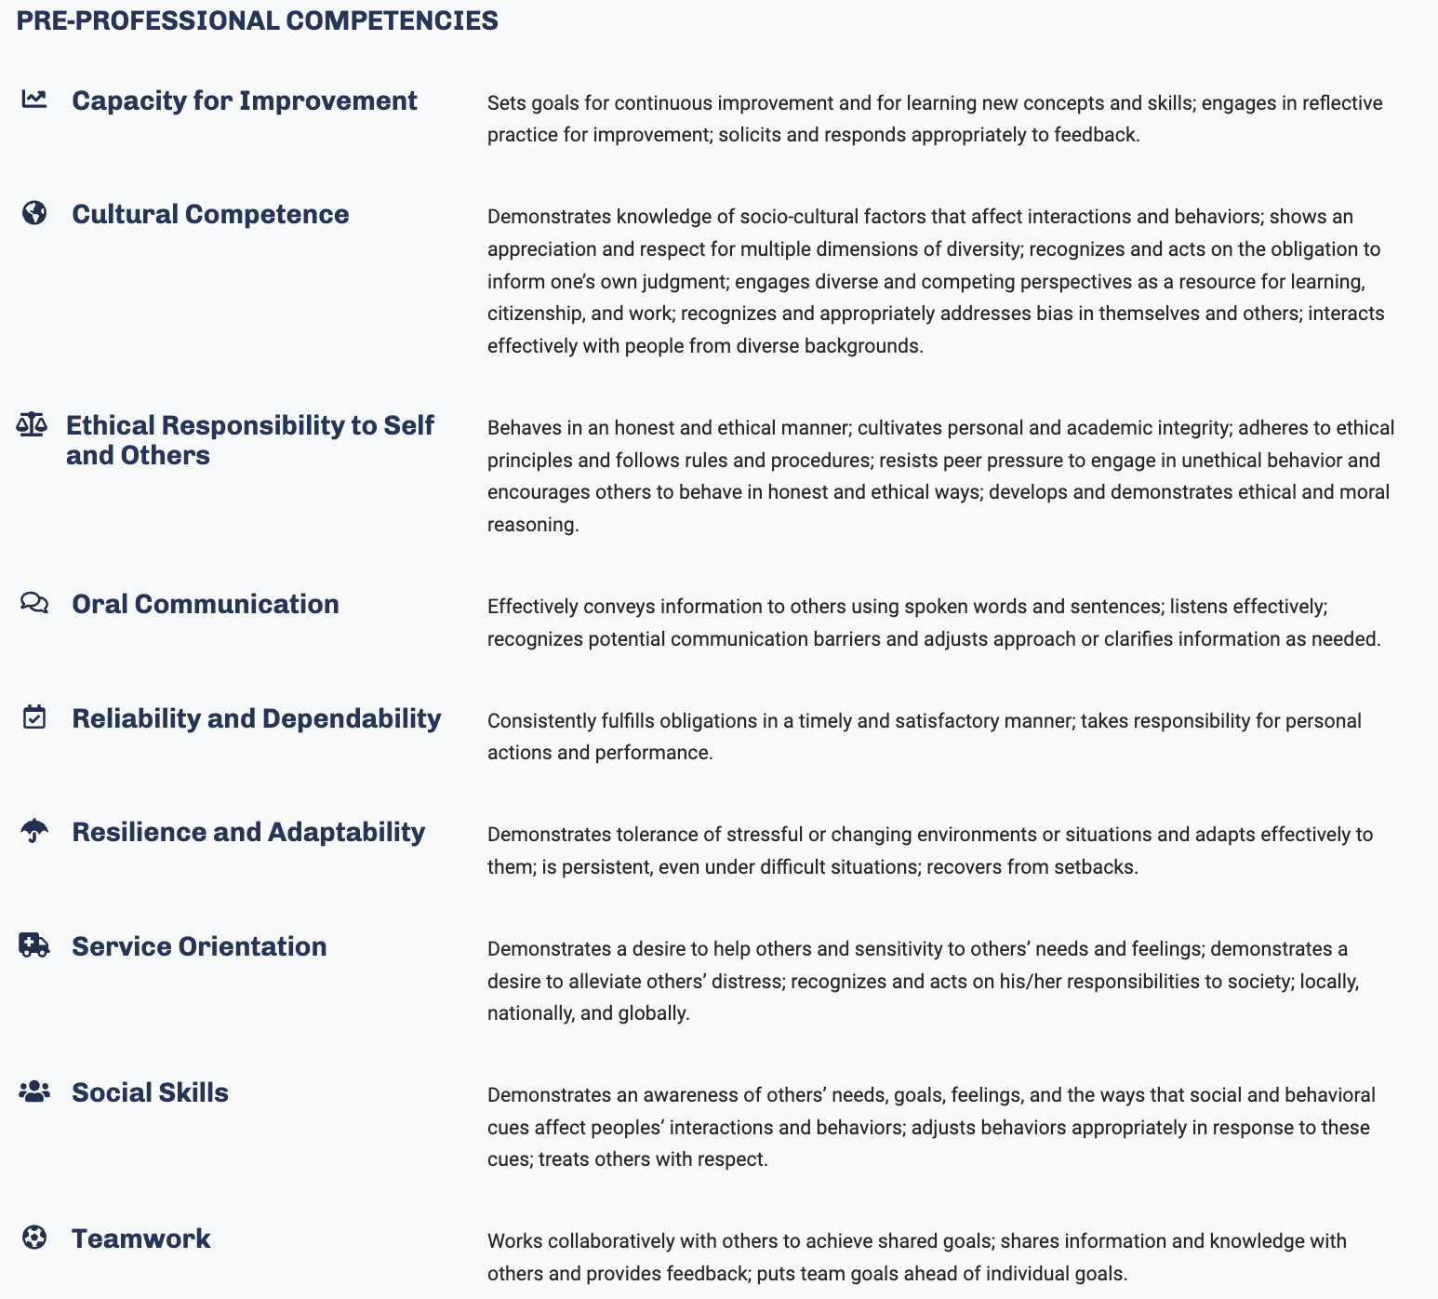
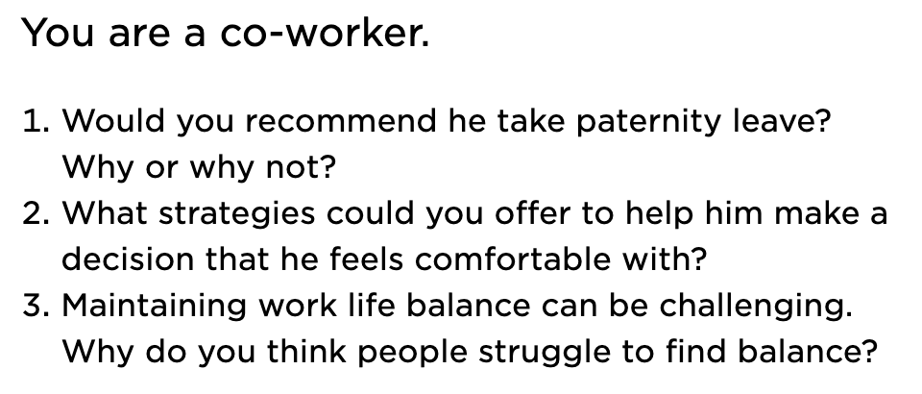
Components of a Successful Med School App
Situational Judgement Test (SJT)
III. AAMC PREview® Professional Readiness Exam
series of hypothetical scenarios students may encounter in medical school and asks examinees to evaluate the effectiveness of a series of behavioral responses to each scenario.
assess examinees’ understanding of effective pre-professional behavior most relevant for entering medical students.
IV. CASPer
Computer-based Assessment for Sampling Personal Characteristics.
https://acuityinsights.app/test-prep/
Notes:
Leen

Slide 11
Components of a Successful Med School App
III. Extracurricular Activities
Why do extracurriculars?
Public service
- Talk to Adams House public service tutors!
- Public service organizations at Harvard: https://publicservice.fas.harvard.edu/
c. Clinical experiences (critical)
- Shadowing at local hospitals: Mt Auburn/ Cambridge Health Alliance, Project HEALTH,
- Volunteering (CrimsonEMS, Crimson Care Collaborative, HCAB)
- Red Cross Disaster Relief
- Senior NRTs
- Crimson Care Collaborative (CCC) at HMS
- Harvard College Alzheimer’s Buddies
d. Athletics/ Music/ Other
e. Leadership positions
Notes:
Leen

Slide 12
Components of a Successful Med School App
IV. Sustained scholarly project
Medically-oriented research
Importance of basic science or clinical research, NOT a requirement!
Selecting a laboratory to work in
Duration of research
Relationship with professor or doctor
Research credit/funding opportunities
Senior Honors Thesis (in any field!)
Notes:
Leen

Slide 13
Components of a Successful Med School App
V. Recommendations – Work on building a relationship with a faculty during both science and humanities courses.
Get to know your teaching fellow/professor-> go to office hours, participate in discussions etc.
Do not procrastinate, and ask while they will remember you
It is often good to ask the faculty shortly after the class ends whether they might want to write a recommendation for you. You can then follow up with them when you do start the application cycle
Ask EARLY - Important to not wait until the last minute!
Ask for one each semester
Explicitly ask if they can write a STRONG letter of recommendation
Asking for a letter can be done in-person or by email. Both strategies have advantages. In-person adds a nice personal touch and by email allows a prof or TF to make an excuse if they don’t have time or don’t feel like they can write a STRONG letter of recommendation
If teaching fellow is writing, highly recommend that professor co-signs.
Timeline -> ask and provide instructions several months ahead of time → i.e. by March at the latest
Notes:
Leen

Slide 14
Components of a Successful Med School App
V. Recommendations (continued) Make a “Packet” for Your Letter Writers
Info to give a letter writer:
A cover letter (or explanation for interest in medicine) and CV/Resume
A waiver form (house form)
AAMC Guide to Letter Writers
Guidelines (OCS) for writing a pre-med letter
The format of the letter: Ask that the letter be written on official letterhead with a signature included at the end.
Letters of recommendations need to be addressed along the lines of “To the Medical School Admissions Committee” or “To the Veterinary School Admissions Committee.” AVOID addressing LOR to specific schools (To HMS)
Where the letter should be sent: The letter should be sent by email to the Adams Academic Coordinator at adams_coordinator@fas.harvard.edu. Subject line: "Letter of recommendation for medical school - FirstName LastName"
At least two science letters from course instructors, one letter from concentration, and one extra-curricular or non-science instructor letter, try to find someone who could speak to your potential as a physician
Inviting your faculty and TFs to Faculty Dinners hosted every semester in Adams House is a good way to get to know your professors and Teaching Fellows on a more personal level
Notes:
Leen

Slide 15
Considering Dual Degrees
I. MD/Ph.D.:
These programs can be NIH funded (MSTP); there are ~40 programs around the country with funded MD/Ph.D. spots.
Some MD/PhD programs offer non-funded spots; think carefully about whether you want to do this
The savings from the fully-funded status must be weighed against the years (3-5) that the Ph.D. takes to complete
Apply at the same time as you apply to medical school (the app is longer, interview process slightly different)
Talk with our MD/Ph.D. tutors (Dan K., Dan E., David, Maud) for advice
Think carefully about what you are trying to achieve with the two degrees.
As an alternative to the PhD, many students engage in 1-2 years of research during medical school through various funding agencies (HHMI, NIH, Doris Duke, etc), or pursue a Master’s degree in clinical research/public health/basic science.
However, bear in mind that if your goal is to do research as a major part of your career, you will need to put sufficient time in to get research training somewhere - whether it’s through a PhD, or through a 3-4 year post-doc/fellowship after MD/residency.
If you like research but anticipate it being more of a side hustle, a PhD is probably overkill; consider a Master’s degree
Notes:
Maud

Slide 16
Considering Dual Degrees
Considerations for a successful MD/PhD application:
Get involved in research early. This can be basic science research, clinical science research, social science research, etc.
Nowadays, can do a PhD in anthropology, health policy, epidemiology, economics, etc.
Far fewer spots for social science programs (~1-2/year per school), but fewer applicants
Ideally, do research in the field you are interested in doing a PhD in.
Social science PhDs typically want to see 2-3 years of field-specific experience by the time you apply (can do undergrad research and/or master or other related research; can be some transfer between humanities and history vs. anthro but varies per program)
For basic science students, the type of lab research you do is not as important - e.g., you could do neurobiology research in college and then decide to do a PhD in immunology, the skills will translate even if your interests change.
Find a good mentor. Lab w/ incredible mentor and slightly less interesting topic >>> lab with interesting topic and bad mentor.
Productivity is important. Publications great but not necessary; however, try to have abstracts, conference presentations, etc.
Have early and prolonged clinical experience, leadership, public service, etc. identical to a straight MD applicant
Clinical exposure is essential to getting in; a prolific research profile does not make up for lack of clinical experience
Overall competitiveness tends to be slightly higher (higher average MCAT & GPA), but matriculation percentages are similar between MD/PhD programs and MD programs because there are fewer MD/PhD applicants
In 2021-2022, matriculation % for both MD/PhD applicants and for MD applicants was 36%
However, there were 62,443 MD applicants and 2,091 MD/PhD applicants
MD/PhD matriculant mean GPA 3.8 / MCAT 516; MD matriculant mean GPA 3.7 / MCAT 512
Notes:
Maud

Slide 17
Considering Dual Degrees
I. MD/MBA, MD/MPH, MPP (@ Kennedy School), MS (vs MD/PhD)
Many schools now offer these programs
- Both usually just add one year to your training (5 years vs. 4 years)
- Important to note because if you do a Master’s pre-MD, it is 2 years ($$), whereas if you do it during/post MD it is only 1
Think carefully about what you are trying to achieve with the two degrees. Do you need both? Which one do you most want and which is secondary?
You do not need to apply to these at the same time as your application to medical school (unlike MD/PhD); you typically apply in second or third year of med school (or any time after finishing)
You do not have to do your second degree at the same place that you do your MD
Notes:
Maud

Slide 18
Special Considerations for COVID-19
Coursework
Harvard’s Spring 2020 universal satisfactory/unsat course grading system will not affect medical school admissions. In fact most, if not all, medical schools will access pass/fail graded courses taken during the COVID-19 pandemic.
Previously, lab classes would only be accepted if they were taken as in-person courses. Most schools will accept online lab coursework taken due to the COVID-19 pandemic.
Letters of Recommendations (LOR):
a. Continue to remain engaged in your classes. Attend offices and do not be afraid to ask for LORs.
Hardship:
a. AAMC Fee Assistance Program has expanded its eligibility guidelines to help more students with financial needs qualify for benefits.
i. FAP available to US citizen, nation or lawful permanent resident, refugee/asylee by the US gov, DACA
recipients or person awaiting refugee/asylee status approval.
ii. FAP will be granted to students whose household has a family income that is 400% or less than the prior
year’s poverty level for that family size.
iii. Benefits: MCAT test prep materials, reduced MCAT fee, MSAR, potential residency bonuses for housing
assistance
Notes:
Dan

Slide 19
Special Considerations for COVID-19
IV. Clinical experiences and shadowing
Be creative! The goal is for you to spend enough time in clinical settings to ascertain that you want to work in them. Remember, shadowing is so much more than another pre-med requirement, it also helps you ascertain if the clinical environment is the right fit for YOU.
Remember to pick clinical opportunities that are safe and that do not put you or anyone else at risk
Breadth or depth are both acceptable!
Places to look:
Your own network
Local hospital volunteering (Mass General, Cambridge Health Alliance)
Student volunteering (CrimsonEMS, Crimson Care Collaborative)
Cold email physicians (in-person vs virtual shadowing, trainee vs someone further into their career)
There are many alternative opportunities to physician-shadowing including volunteering in a hospice, becoming an EMT, becoming hospital/clinic scribes, caretaking (broadly speaking)
Notes:
Dan

Slide 20
COVID-specific resources/webpages
V Application process:
In order to give pre-meds access to accurate application, specific information, AAMC has made the MSAR report publicly available and will update this frequently
2024 AMCAS Updates:
https://students-residents.aamc.org/applying-medical-school/2024-amcas-updates-and-faqs
Khan Academy MCAT course:
https://www.khanacademy.org/test-prep/mcat
Medical School Admission Requirements (MSAR) advisor report
Notes:
Dan
The medical school admission requirements (MSAR) advisor report is a PDF made accessible to premed advisors which provides detailed admission policies for medical schools in the US. Due to the unprecedented COVID 19 pandemic, this document has now been made publicly accessible and is updated regularly. (Most helpful for students hoping to matriculate in 2021 but can be useful to start to learn some of the accommodations medical schools have started making due to the disruptions or transitions to remote learning and virtual experiences.)

Slide 21
Application Year Calendar
*MCS has useful workshops as well—see their webpage for schedule
*Ongoing: be sure to register for the MCAT!
I. December 2023
For those applying in the next cycle, you should meet with NRT by this time!
Ask for recommendations before you leave for break.
II. February 2024
Mandatory Meeting for all applying students this current cycle.
Finish asking for recommendations
*This meeting is also required for seniors who are not applying, but leaving the house
Notes:
David
Office of Career Services
mid-October MCAT registration opens up for MCAT dates from January through June.

Slide 22
Application Year Calendar
III. March 2024
All recommendations from previous semesters due
Intention to apply to medical school form
- We will reach out to you closer to March with instructions on how to submit these documents
Check in with NRT to discuss pre-med packet and application by March
Premedical Packet due to the House (we will provide instructions on how to submit)
- Provides extensive information to us / NRTs in writing the Dean’s letter
- Helps you better define interests and goals in pursuing medicine as a career
- Includes a complete list of recommendation letter writers
Materials must be submitted on time in order to take full advantage of the mock interviews (see below)
Missing letters of recommendation WILL delay your application.
Notes:
David

Slide 23
Application Year Calendar
IV. April 2024
Mock interviews: mid-April
- Opportunity to experience interview in a no/low-stress setting
- Helpful comments from our NRT staff on the interviewing process.
Personal statement and Interview workshop: late-April
V. June 2024
a. Your AMCAS application should be completed by mid-June.
b. Online application and details can be found on AMCAS website.
c. MCAT must have been completed by late June (at the latest).
Notes:
David

Slide 24
Application Year Calendar
Alum in your Gap Years? You must contact us in the Fall of the year before you apply so that we can set you up with an NRT.
a. Example: If you are five years out and planning on submitting your application in June 2024, you should contact us (adams-medical@lists.fas.harvard.edu) in the Fall of 2023.
QUESTIONS? Please look at the Adams Premed and OCS WEBSITES first.
Then email adams-medical@lists.fas.harvard.edu if you cannot find the answers!
Notes:
David
Office of Career Services

Slide 25
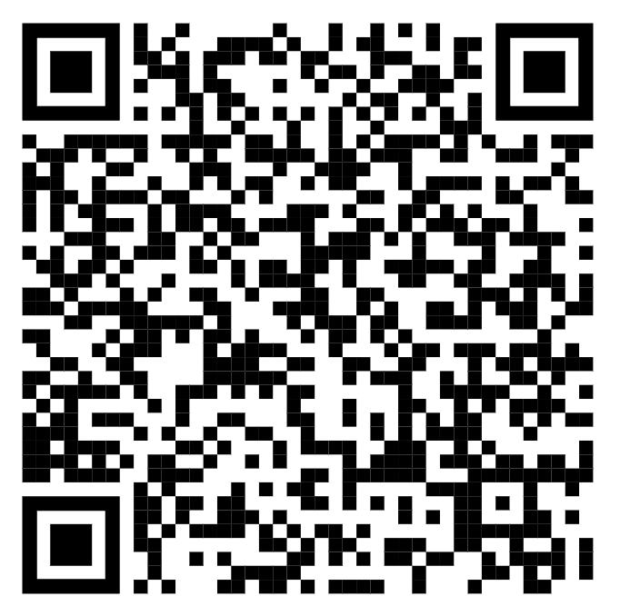
The Form! (Adams Pre-Health Info Form)

